Slide 1
Department of Applied Mathematics and Computational Sciences
III Sem M.Sc.Software Systems
Transform Techniques
Dr. V. Suresh kumar

Slide 2
Inverse Z Transform

Slide 3

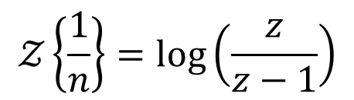
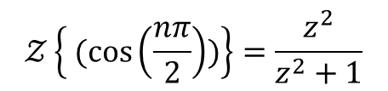
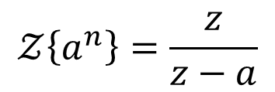
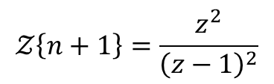
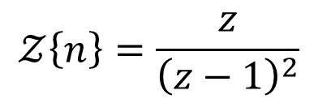
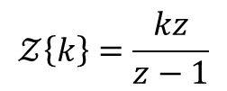
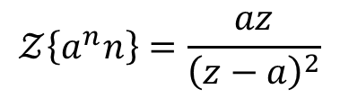

Table of Transform
$$𝒵\left\{a^{n}\right\}=\frac{z}{z−a}$$
$$𝒵\left\{\frac{1}{n}\right\}=\log\left(\frac{z}{z−1}\right)$$
$$𝒵\left\{k\right\}=\frac{kz}{z−1}$$
$$𝒵\left\{ (\cos\left(\frac{nπ}{2}\right))\right\}=\frac{z^{2}}{z^{2}+1}$$
$$𝒵\left\{n\right\}=\frac{z}{{\left(z−1\right)}^{2}}$$
$$𝒵\left\{(\sin\left(\frac{nπ}{2}\right))\right\}=\frac{z}{z^{2}+1}$$
$$𝒵\left\{a^{n}n\right\}=\frac{az}{{\left(z−a\right)}^{2}}$$
$$𝒵\left\{n+1\right\}=\frac{z^{2}}{{\left(z−1\right)}^{2}}$$
$$𝒵\left\{1\right\}=\frac{z}{z−1}$$

Slide 4

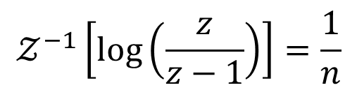
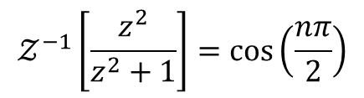
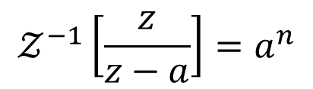
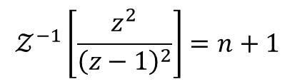

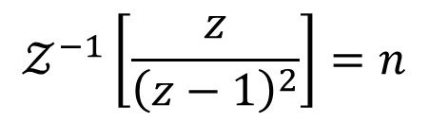
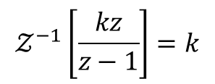
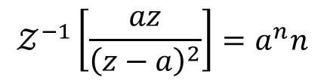

Table of Inverse Transform
$$𝒵^{−1}[X\left(z\right)]=\{x(n)\}$$
$$𝒵^{−1}\left[\frac{z}{z−a}\right]=a^{n}$$
$$𝒵^{−1}\left[\frac{z}{z^{2}+1}\right]=\sin\left(\frac{nπ}{2}\right)$$
$$𝒵^{−1}\left[\log\left(\frac{z}{z−1}\right)\right]=\frac{1}{n}$$
$$𝒵^{−1}\left[\frac{z}{z−1}\right]=1$$
$$𝒵^{−1}\left[\frac{z}{{\left(z−1\right)}^{2}}\right]=n$$
$$𝒵^{−1}\left[\frac{kz}{z−1}\right]=k$$
$$𝒵^{−1}\left[\frac{az}{{\left(z−a\right)}^{2}}\right]=a^{n}n$$
$$𝒵^{−1}\left[\frac{z^{2}}{{\left(z−1\right)}^{2}}\right]=n+1$$
$$𝒵^{−1}\left[\frac{z^{2}}{z^{2}+1}\right]=\cos\left(\frac{nπ}{2}\right)$$

Slide 5
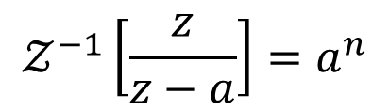
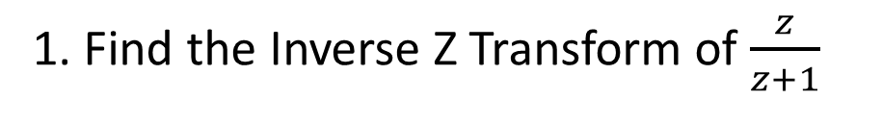
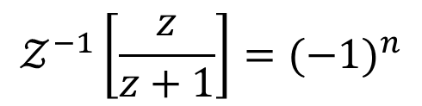
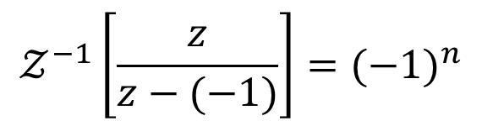
Examples
1. Find the Inverse Z Transform of $\frac{z}{z+1}$
Ans
$$𝒵^{−1}\left[\frac{z}{z−a}\right]=a^{n}$$
$$𝒵^{−1}\left[\frac{z}{z−(−1)}\right]={(−1)}^{n}$$
$$𝒵^{−1}\left[\frac{z}{z+1}\right]={(−1)}^{n}$$

Slide 6
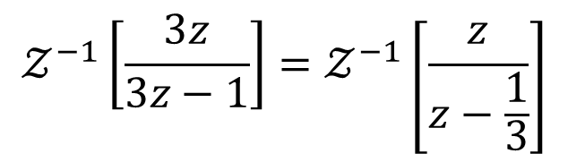
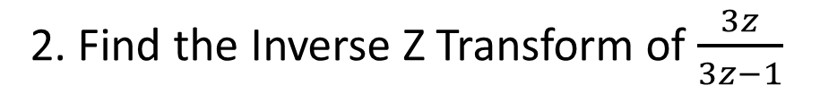
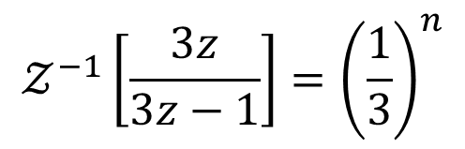
Examples contd…
2. Find the Inverse Z Transform of $\frac{3z}{3z−1}$
Ans
$$𝒵^{−1}\left[\frac{3z}{3z−1}\right]=𝒵^{−1}\left[\frac{z}{z−\frac{1}{3}}\right]$$
$$𝒵^{−1}\left[\frac{3z}{3z−1}\right]={\left(\frac{1}{3}\right)}^{n}$$

Slide 7
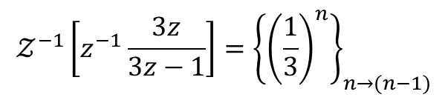

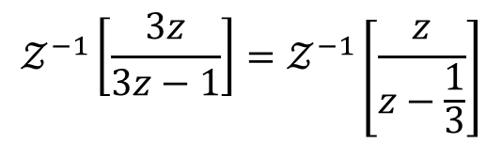
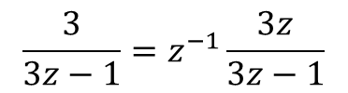

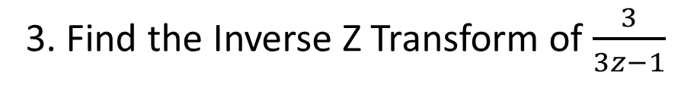




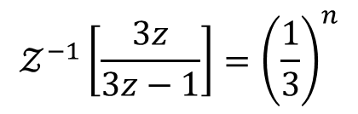
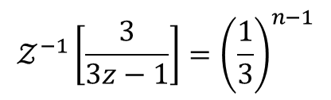
Examples contd…
3. Find the Inverse Z Transform of $\frac{3}{3z−1}$
$$𝒵\left\{x\left(n−1\right)\right\}=z^{−1}𝒵\left\{x\left(n\right)\right\}$$
Ans
$$𝒵^{−1}\left[z^{−1}𝒵\left\{x\left(n\right)\right\}\right]={\left\{x(n)\right\}}_{n→(n−1)}$$
$$𝒵^{−1}\left[\frac{3z}{3z−1}\right]=𝒵^{−1}\left[\frac{z}{z−\frac{1}{3}}\right]$$
$$\frac{3}{3z−1}=z^{−1}\frac{3z}{3z−1}$$
$$𝒵^{−1}\left[\frac{3z}{3z−1}\right]={\left(\frac{1}{3}\right)}^{n}$$
Using shifting property
$$𝒵^{−1}\left[z^{−1}\frac{3z}{3z−1}\right]={\left\{{\left(\frac{1}{3}\right)}^{n}\right\}}_{n→(n−1)}$$
$$𝒵\left\{x\left(n−k\right)\right\}=z^{−k}𝒵\left\{x\left(n\right)\right\}$$
$$𝒵\left\{x\left(n−k\right)\right\}=z^{−k}X(z)$$
$$𝒵^{−1}\left[\frac{3}{3z−1}\right]={\left(\frac{1}{3}\right)}^{n−1}$$
Where $X\left(z\right)=𝒵\left\{x\left(n\right)\right\}$
$$𝒵^{−1}\left[z^{−k}X(z)\right]={\left\{x(n)\right\}}_{n→(n−k)}$$

Slide 8







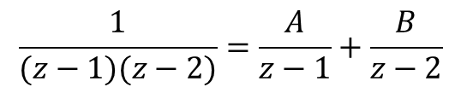
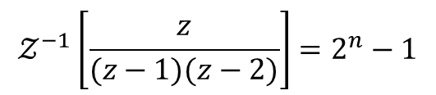
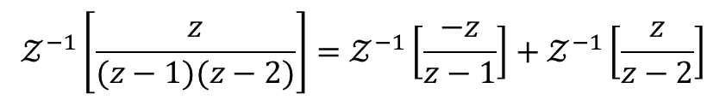
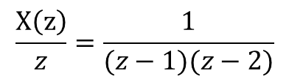
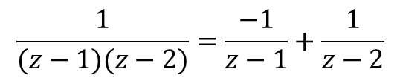

Examples contd…
4. Find the Inverse Z Transform of $\frac{z}{(z−1)(z−2)}$
$$\frac{X\left(z\right)}{z}=$$
$$\frac{1}{(z−1)(z−2)}=\frac{−1}{z−1}+\frac{1}{z−2}$$
Sol.
Take $X\left(z\right)=\frac{z}{(z−1)(z−2)}$
$$X\left(z\right)=\frac{−z}{z−1}+\frac{z}{z−2}$$
$$\frac{X\left(z\right)}{z}=\frac{1}{(z−1)(z−2)}$$
$$𝒵^{−1}\left[\frac{z}{(z−1)(z−2)}\right]=𝒵^{−1}\left[\frac{−z}{z−1}\right]+𝒵^{−1}\left[\frac{z}{z−2}\right]$$
$$\frac{1}{(z−1)(z−2)}=\frac{A}{z−1}+\frac{B}{z−2}$$
$$=−𝒵^{−1}\left[\frac{z}{z−1}\right]+𝒵^{−1}\left[\frac{z}{z−2}\right]$$
$$1=A\left(z−2\right)+B(z−1)$$
$$=−{\left(1\right)}^{n}+2^{n}$$
$$A=−1$$
$$𝒵^{−1}\left[\frac{z}{(z−1)(z−2)}\right]=2^{n}−1$$
$$B=1$$

Slide 9





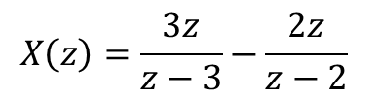
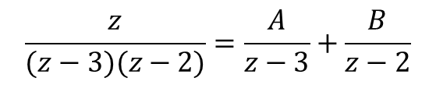
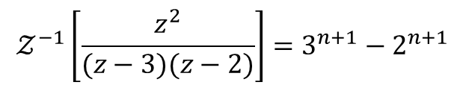
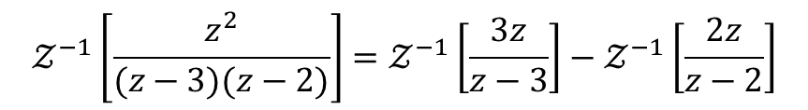
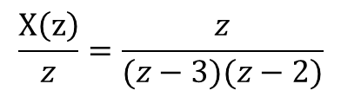
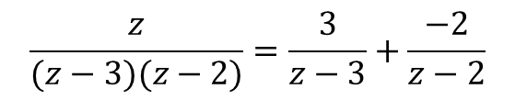

Examples contd…
5. Find the Inverse Z Transform of $\frac{z^{2}}{(z−3)(z−2)}$
$$\frac{X\left(z\right)}{z}=$$
$$\frac{z}{(z−3)(z−2)}=\frac{3}{z−3}+\frac{−2}{z−2}$$
Sol.
Take $X\left(z\right)=\frac{z^{2}}{(z−3)(z−2)}$
$$X\left(z\right)=\frac{3z}{z−3}−\frac{2z}{z−2}$$
$$\frac{X\left(z\right)}{z}=\frac{z}{(z−3)(z−2)}$$
$$𝒵^{−1}\left[\frac{z^{2}}{(z−3)(z−2)}\right]=𝒵^{−1}\left[\frac{3z}{z−3}\right]−𝒵^{−1}\left[\frac{2z}{z−2}\right]$$
$$\frac{z}{(z−3)(z−2)}=\frac{A}{z−3}+\frac{B}{z−2}$$
$$=3𝒵^{−1}\left[\frac{z}{z−3}\right]−2𝒵^{−1}\left[\frac{z}{z−2}\right]$$
$$z=A\left(z−2\right)+B(z−3)$$
$$=3{\left(3\right)}^{n}−2({2)}^{n}$$
$$A=3$$
$$𝒵^{−1}\left[\frac{z^{2}}{(z−3)(z−2)}\right]=3^{n+1}−2^{n+1}$$
$$B=−2$$

Slide 10
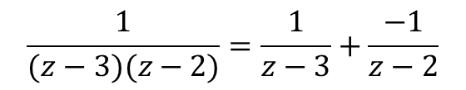
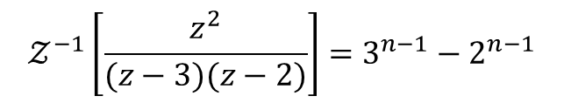




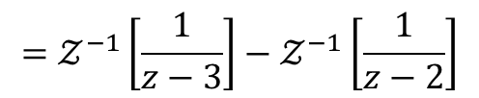

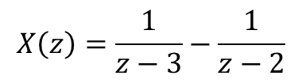
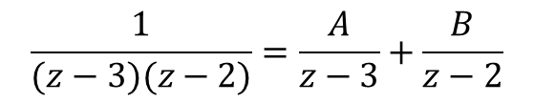
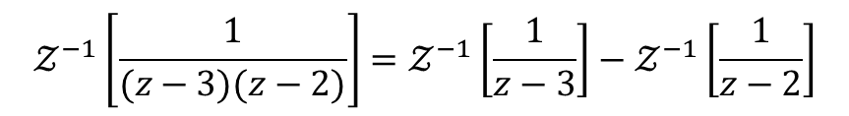
Examples contd…
6. Find the Inverse Z Transform of $\frac{1}{(z−3)(z−2)}$
Sol.
Take $X\left(z\right)=\frac{1}{(z−3)(z−2)}$
$$X\left(z\right)=\frac{1}{z−3}−\frac{1}{z−2}$$
$$\frac{1}{(z−3)(z−2)}=\frac{A}{z−3}+\frac{B}{z−2}$$
$$𝒵^{−1}\left[\frac{1}{(z−3)(z−2)}\right]=𝒵^{−1}\left[\frac{1}{z−3}\right]−𝒵^{−1}\left[\frac{1}{z−2}\right]$$
$$1=A\left(z−2\right)+B(z−3)$$
$$A=1$$
$$=𝒵^{−1}\left[\frac{1}{z−3}\right]−𝒵^{−1}\left[\frac{1}{z−2}\right]$$
$$B=−1$$
$$={\left(3\right)}^{n−1}−({2)}^{n−1}$$
$$\frac{1}{(z−3)(z−2)}=\frac{1}{z−3}+\frac{−1}{z−2}$$
$$𝒵^{−1}\left[\frac{z^{2}}{(z−3)(z−2)}\right]=3^{n−1}−2^{n−1}$$

Slide 11

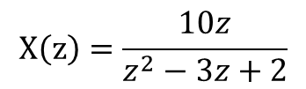
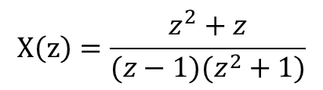
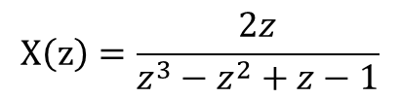
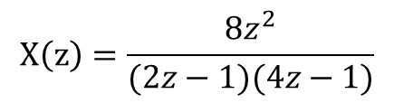
Problems for practice
Find the Inverse Z Transform for the following
$$X\left(z\right)=\frac{10z}{z^{2}−3z+2}$$
(1)
$$X\left(z\right)=\frac{z}{z^{2}+7z+10}$$
(2)
(3)
$$X\left(z\right)=\frac{8z^{2}}{(2z−1)(4z−1)}$$
$$X\left(z\right)=\frac{z^{2}+z}{(z−1)(z^{2}+1)}$$
(4)
$$X\left(z\right)=\frac{2z}{{z^{3}−z}^{2}+z−1}$$
(5)

Slide 12


